Slide 1

Fundamental of JAVA Programming
UNIT :- V
Exception Handling , Multithreading, Applet

Slide 2
Types of Errors
Type of Error
Compile Time Error
Run Time Error

Slide 3
Compile Time Errors
All syntax errors will be detected and displayed by the Java compiler ,these errors are called as compile time errors.
Whenever the compiler displays an error, it will not create the .class file
It is necessary to fix all these errors before we can successfully compile and run the program
class Myclass
{
public static void main (String args [])
{
System.out.println(“Hello Java”)
}
}
Syntax error, insert ";" to complete BlockStatements

Slide 4
Reasons for Compile Time Errors
Missing Semicolons
Missing brackets in classes and methods
Misspelling of identifiers and keywords
Missing double quotes in string
Used of undeclared variables
Bad Reference to objects
Use of = in place of == operator

Slide 5
Run Time Errors
Sometime, a program may compile successfully creating the .class file but may not run properly.
Such programs may produce wrong results due to wrong logic or may terminate due to errors.
Most Run time Errors are
1
Dividing an Integer by Zero
2
Out of the bounds of an array
3
Store a value into an array of an incompatible type
4
Passing a parameter that is not in a valid range or value for method
5
Attempting negative size of an array
6
Converting invalid string to a number
7
Accessing a character that is out of bounds of a string

Slide 6
Run Time Error Example
class Myclass
{
public static void main (String args [])
{
int a=10;
int b=5;
int c=5;
int x=a/(b-c); //Division by zero
System.out.println(“ x=”+x);
int y=a/(b+c);
System.out.println(“y=”+y);
}
}
Java.lang.ArithmeticException: /by zero
At Myclass.main(Myclass.java:)

Slide 7
Exceptions
Exception is a condition that is caused by a run time error in the program.
When the Java interpreter encounters an error such as dividing an integer by zero, it creates an exception object and throws
If the exception object is not caught and handled properly, the interpreter will display an error message as shown in the output of program and will terminate the program.
If we want the program to continue with the execution of the remaining code, then we should try to catch the exception object thrown by the error condition and then display an appropriate message for taking corrective actions. This task is known as exception handling.

Slide 8
Exceptions Type
Exception Type | Cause of Exception
ArithmaticException | Caused by math errors such as division by zero
ArrayIndexOutOfBoundException | Caused by bad array indexes
ArrayStoreException | Caused when a program tries to store the wrong type of data in array
FileNotFoundException | Caused by an attempt to access a nonexistent file
IOException | Caused by general I/O failures, such as inability to read from a file
NumberFormatException | Caused when a conversion between strings and numbers fails
OutOfMemoryException | Caused when there’s not enough memory to allocate a new object
SecurityException | Caused when an applet tries to perform an action not allowed by the browser security setting
StackOverFlowException | Caused when the system runs out of stack space
StringIndexOutOfBoundException | Caused when a program attempts to access a nonexistent character position in a String

Slide 9
Error Handling
For Error Handling performs the following tasks
Find the problem (Hit the exception)
Inform that an error has occurred (throw the exception)
Receive the error information (catch the exception)
Take corrective actions (handle the exception)
Java Exception Handling is managed by five keywords
try{……..……….}
catch{…………….}
throw
throws
finally{…………..}

Slide 10
Syntax of Exception Handling Code
try block
Statement that cause an exception
……..
……..
try
{
statement; //Generates an Exception
}
catch (Exception-Type e)
{
statement ; //Processes the exception
}
……………….
…………….
Exception Object Creator
Throw Exception Object
catch block
Statement that handle an exception
Exception Handler

Slide 11
Exception Handling In Java
class Myclass
{
public static void main (String args [])
{
int a=10;
int b=5;
int c=5;
int x,y;
try
{
x=a/(b-c); //Exception Here
System.out.println(“ x=”+x);
}
catch(ArithmeticException e)
{
System.out.println(“Division by zero”+ “Please take a
different value of c” );
}
int y=a/(b+c);
System.out.println(“y=”+y);
}
Output:-
Division by zero Please take a different value of c
y=1

Slide 12
Exception Handling In Java
class CLineInput
{
public static void main (String args [])
{
int invalid= 0; //Number of Invalid Argument
int number, count=0
for(int i=0;i<args.length;i++)
{
try
{
number=Integer.parseInt(args[i]);
}
catch(NumberFormatException e)
{
invalid=invalid +1; //Caught an Invalid Number
System.out.println(“Invalid Number:- “+args[i]);
continue;
}
count=count+1;
} //End of For loop
System.out.pirntln(“Total Valid Number=”+count);
System.out.println(“Total Invalid Number=”+invalid);
}
}
Java ClineInput 15 25.75 40 Java 10.5 65
Output:-
Invalid Number:- 25.75
Invalid Number:- Java
Invalid Number:- 10.5
Total Valid Number:- 3
Total Invalid Number:- 3

Slide 13
Multiple Catch Statement
……..
……..
try
{
statement; //Generates an Exception
}
catch (Exception-Type-1 e)
{
statement ; //Processes the exception type 1
}
catch(Exception-Type-2 e)
{
statement; //Process the exception type 2
}
.
.
.
catch(Exception Type-N e)
{
statement;
}
try block
Statement that cause an exception
Exception Object Creator
Throw Exception Object
catch block 1
Statement that handle the exception
Exception Handler 1
catch block 2
Statement that handle the exception
Exception Handler 2

Slide 14
Example of Multiple Catch Blocks
class MyClass
{
public static void main (String args [])
{
int a[] = {5,10};
int b=5;
try
{
int x=a[2]/b – a[1];
}
catch(ArithmeticException e)
{
System.outprintln(“Division by zero”);
}
catch (ArrayIndexOutOfBoundsException e)
{
System.out.println(“Array Index Error”);
}
catch(ArrayStoreException e)
{
System.out.println(“Wrong Data Type”);
}
int y=a[1]/a[0];
System.out.println(“y=”+y);
}
}
Output:-
Array Index Error
y =2

Slide 15
Exception Handling Code with Finally Statement
Finally statement that can be used to handle an exception that is not caught by any of the previous catch statements.
Finally block can be used to handle any exception
It may be added immediately after the try block or after the last catch block
When finally block is defined, then it is guaranteed to execute, regardless of whether or not an exception is thrown
try
{
statement; //Generates an Exception
}
catch (Exception-Type e)
{
statement ; //Processes the exception
}
catch (Exception-Type e)
{
statement ; //Processes the exception
}
finally
{
statement ; //Processes the exception
}
try
{
statement; //Generates an Exception
}
finally
{
statement ; //Processes the exception
}
……………….

Slide 16
Example of Multiple Catch Blocks with Finally
class MyClass
{
public static void main (String args [])
{
int a[] = {5,10};
int b=5;
try
{
int x=a[2]/b – a[1];
}
catch(ArithmeticException e)
{
System.outprintln(“Division by zero”);
}
catch (ArrayIndexOutOfBoundsException e)
{
System.out.println(“Array Index Error”);
}
catch(ArrayStoreException e)
{
System.out.println(“Array Index Error”);
}
catch(ArrayStoreException e)
{
System.out.println(“Wrong Data Type”);
}
finally
{ int y=a[1]/a[0];
System.out.println(“y=”+y);
}
}
Output:-
Array Index Error
y =2

Slide 17
Unit No.5, Part I Assignment No.9
Implement the exception handling using try and catch statements to solve runtime errors.
Assignment Deadline :-

Slide 18
Fundamental of JAVA Programming
UNIT :- V
Exception Handling , Multithreading, Applet
Topic
Applet

Slide 19
Applet
Java Programs are available in two flavours
Application :- It is similar to all other kind of programs like in C , C++ etc. to solve a real time problem
Applet :- Applet is small Java programs that performs specific task and primarily used in internet computing
They can be transported over the Internet from one computer to another and run using the Applet viewer or any web browser that supports Java.
An applet , like any application program, can do many things for us. It can perform arithmetic operations, display graphics, play sounds, accept user input, create animation and play interactive games.
A web page can now contain not only a simple text or a static image but also a Java applet which run graphics, sounds and moving images.

Slide 20
Local and Remote Applet
We can embed applets into web pages in two ways
One , we can write our own applet and embed them into web pages
Second, we can download an applet from a remote computer system and then embed into a web page.

Slide 21
How Applets Differ from Applications
Applets and stand alone applications are Java programs
Significant difference between them:- Applets are not full featured application programs.
They are usually written to complete a small task or a component of a task.
They are usually designed for use on the internet
Applets do not use the main() method for initiating the execution of the code
Unlike stand alone application, applets can not be run independently
Applets can not read form or write to the files in the local computer
Applets can not communicate with other servers on the network
Applets can not run any program from the local computer

Slide 22
Preparing to Write Applets
Before we try to write applets, we must make sure that Java is installed properly, and also ensure that either the Java appletviewer or a Java enabled browser is available
Steps involved in developing and testing in applet are
Building an applet code (.java file)
Creating an executable applet (.class file)
Designing a web page using HTML tag
Preparing <APPLET>tag
Incorporating <APPLET> tag into the web page
Testing the applet code

Slide 23
Building Applet Code
Our applet code use the services of two classes, namely, Applet and Graphics from the Java class library.
Applet class which is contained in the java.applet package provides life and behaviour of applet through its methods such as init(), start(), paint(), close().
Therefore Applet class is the life cycle of applet.
paint () method of the Applet class, when it is called, actually displays the result of the applet code on the screen. Output may be text, graphics, sound etc.
paint() method, which requires a Graphics object as an argument is defined as
public void paint(Graphics g)
This requires that the applet code import the java.awt package that contain the Graphics class.
All output operation of an applet are performed using the methods defined in the Graphics class.

Slide 24
Building an Applet Code
Process-1) Import Applet and Graphics class from applet and awt package respectively
Process -2) Define applet class from extending the properties of Applet class
Process-3) Override the method paint that shows the result of applet code
Process -4) By using object of Graphics class access the methods that perform the all operation of applet
Compile this file to creating a .class file for execution of applet code
//File Name is :- AppletClassName.java
import java.applet.Applet;
import java.awt.Graphics;
public class AppletClassName extends Applet
{
-----------------
public void paint(Graphics g)
{
-----------
-----------
}
---------------
---------------
}

Slide 25
Testing a Applet Code
We know the applet are programs that reside on web pages. In order to run a Java applet, it is first necessary to have a web page that references that applet.
Basically web page made up of text and HTML tags that can be interpreted by web browser or an applet viewer.
A web page also called as HTML page
A web page is marked by an opening HTML tag <HTML> and a closing HTML tag </HTML> and its divided into three major sections:
Comment Section (Optional)
Head Section ( Optional)
Body Section

Slide 26
Testing a Applet Code
<HTML>
</HTML>
Comment Section
<!
---- -------
-------------
>
Head Section
<HEAD>
Title Tag
</HEAD>
Body Section
<BODY>
Applet Tag
</BODY>
<applet code = “AppletClassName.class” width =“300” Height=“300”>
</applet>
Save as .html and use appletviewer filename.html commaned to run our applet code

Slide 27
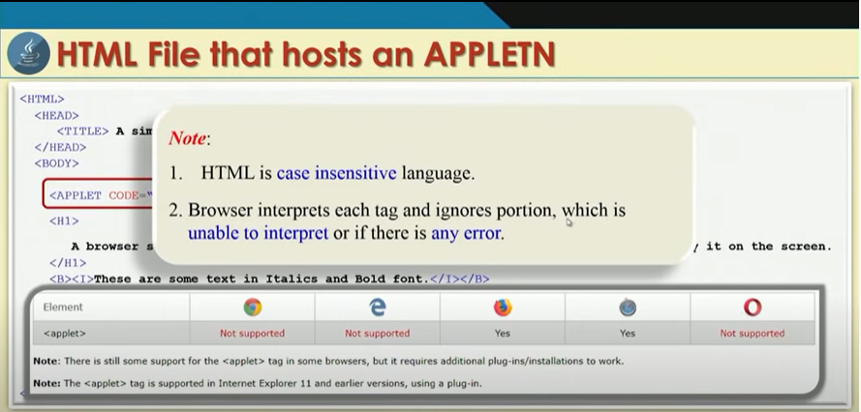

Slide 28
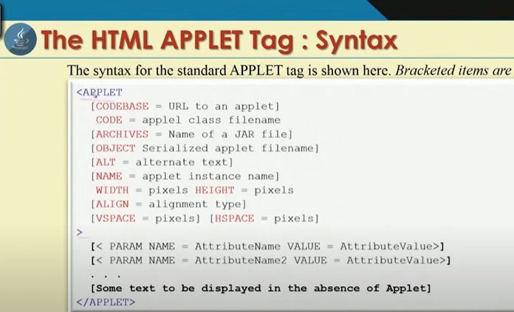

Slide 29
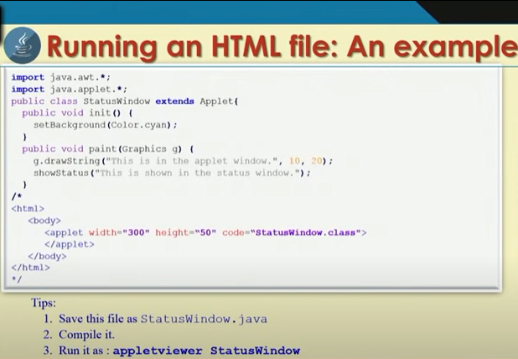

Slide 30
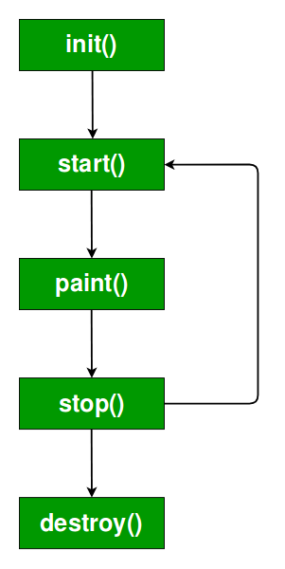
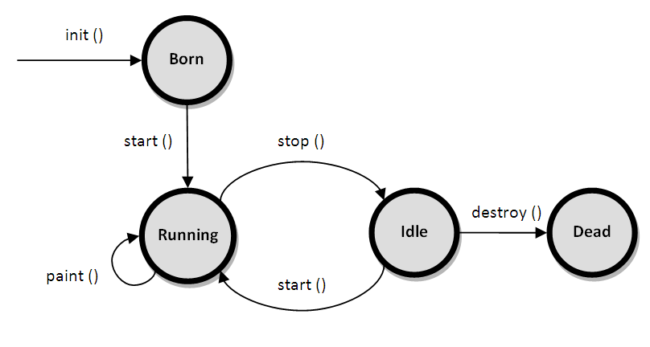
Applet Life Cycle

Slide 31
Basic Methods of Applet
public void init() – To initialize or pass input to an applet
public void start()- start() called after the init() method and it starts an applet
public void stop()- To stop running applet
public void paint(Graphics G)- To draw something within an applet
Public void destroy() – To remove an applet from memory completely

Slide 32
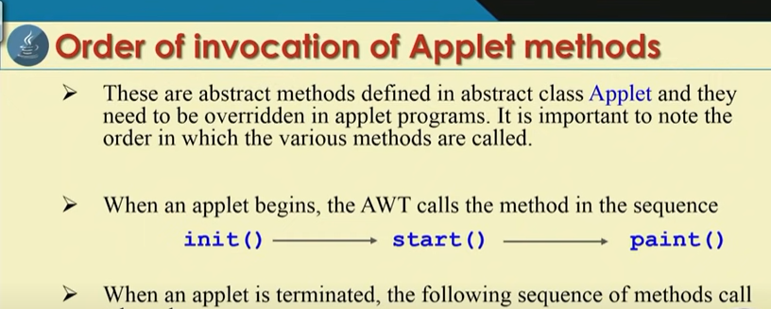


Slide 33
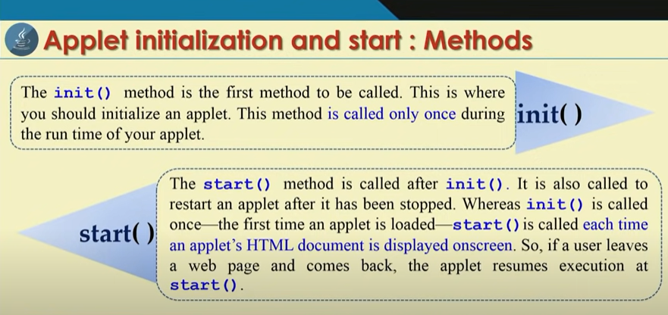

Slide 34
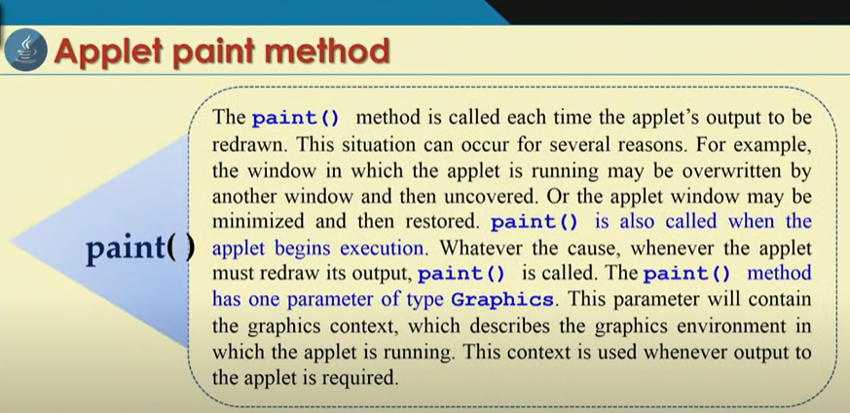

Slide 35
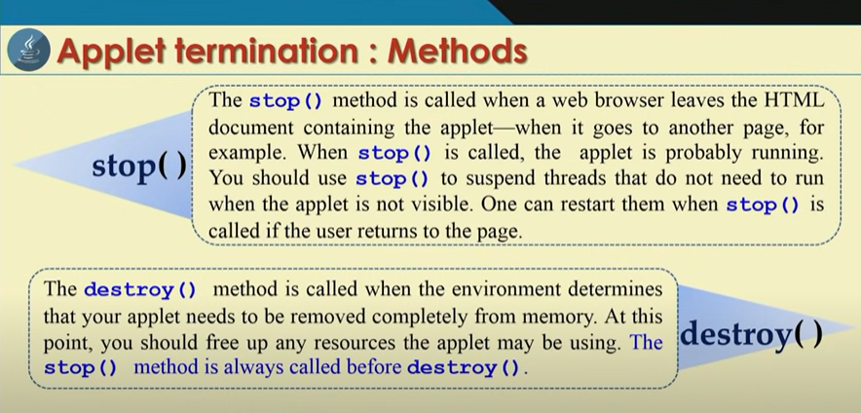

Slide 36
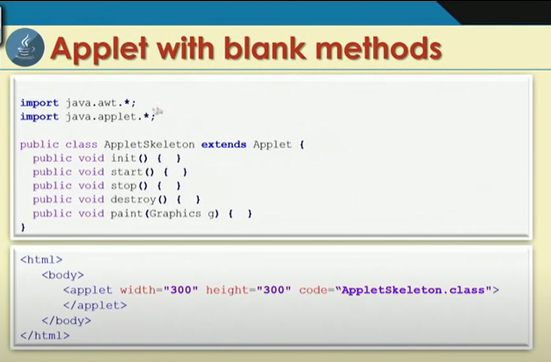
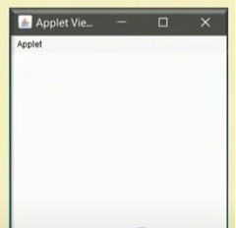

Slide 37
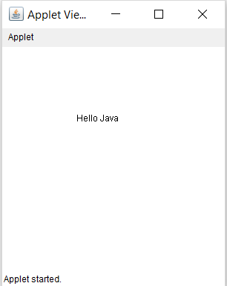
Example :- Print the Hello Java on Applet Window
import java.awt.*;
import java.applet.*;
public class HelloJava extends Applet
{
public void paint(Graphics g)
{
g.drawString("Hello Java", 100,100);
}
}
/*
<html>
<body>
<applet code= "HelloJava.class" width ="300" height="300" >
</applet>
</body>
</html>
*/
*/

Slide 38
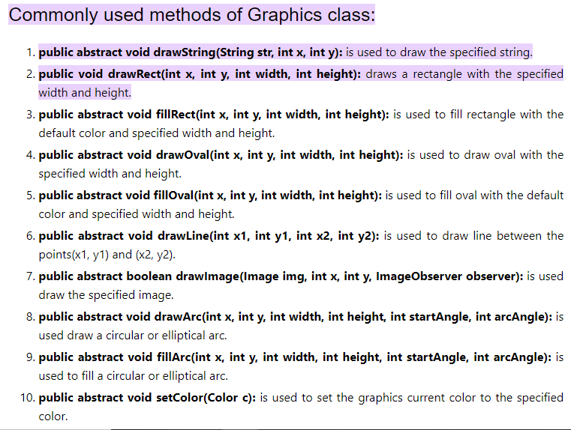

Slide 39
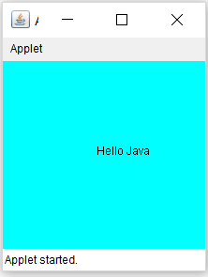
Example
import java.awt.*;
import java.applet.*;
public class HelloJava extends Applet
{
public void init()
{
resize(200,200);
setBackground(Color.cyan);
}
public void paint(Graphics g)
{
g.drawString("Hello Java", 100,100);
}
}
/*
<html>
<body>
<applet code= "HelloJava.class" width ="300" height="300" >
</applet>
</body>
</html>
*/

Slide 40
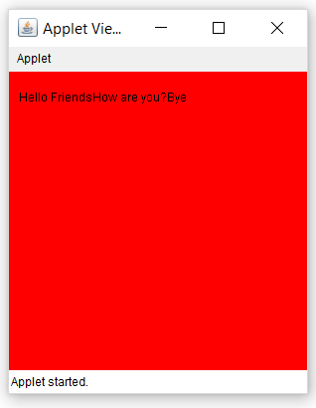
import java. applet.*;
import java. awt.*;
public class Sample extends Applet
{
String msg;
public void init()
{
setBackground(Color.red); // set background and forground color
of applet window
setForeground(Color.black);
msg="Hello Friends .... "; // initialize the string to dispaly
}
public void start()
{
msg += "How are you?....";
}
public void paint(Graphics g)
{
msg+= "Bye…….";
g.drawString(msg,10,30);
}
}
/*
<html>
<body>
<applet code="Sample.class" width="300" height="300">
</applet>
</body>
</html>
*/

Slide 41
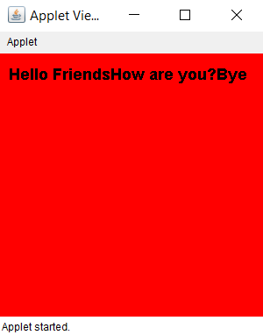
import java. applet.*;
import java. awt.*;
public class Sample extends Applet
{
String msg;
Font f1;
public void init()
{
setBackground(Color.red); // set background and forground color
of applet window
setForeground(Color.black);
msg="Hello Friends .... "; // initialize the string to display
f1 =new Font (“Aerial”,Font.BOLD, 18);
}
public void start()
{
msg += "How are you?....";
}
public void paint(Graphics g)
{
msg+= "Bye…….";
g.setFont(f1);
g.drawString(msg,10,30);
}
}
/*
<html>
<body>
<applet code="Sample.class" width="300" height="300">
</applet>
</body>
</html>
*/

Slide 42
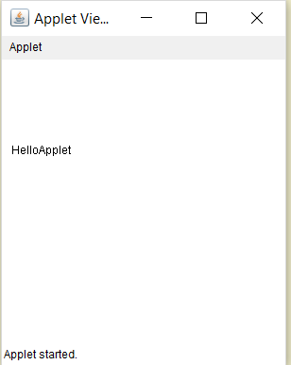
Passing a Parameter to Applet
import java.applet.Applet;
import java.awt.Graphics;
public class Test extends Applet
{
String str;
public void init()
{
str=getParameter("string");
if (str ==null)
str= "Java";
str="Hello"+str;
}
public void paint(Graphics g)
{
g.drawString(str,10,100);
}
}
/*
<html>
<body>
<applet code="Test.class" width="300" height="300">
<param name="string" value="Applet">
</applet>
</body>
</html>
*/

Slide 43
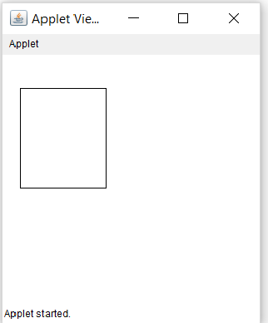
Passing a Parameter to Applet
import java.awt.Graphics;
import java.applet.Applet;
public class Rectangle extends Applet
{
int x,y,w,h;
public void init()
{
x=Integer.parseInt(getParameter("xValue"));
y=Integer.parseInt(getParameter("yValue"));
w=Integer.parseInt(getParameter("wValue"));
h=Integer.parseInt(getParameter("hValue"));
}
public void paint(Graphics g)
{
g.drawRect(x,y,w,h);
}
}
/*
<html>
<body>
<applet code="Rectangle.class" width="300" height="300">
<param name="xValue" value="20">
<param name="yValue" value="40">
<param name="wValue" value="100">
<param name="hValue" value="120">
</applet>
</body>
</html>
*/

Slide 44
Passing a Parameter to Applet
import java.awt.*;
import java.applet.*;
public class UserIn extends Applet
{
TextField text1, text2;
public void init()
{
text1=new TextField(8);
text2=new TextField(8);
add(text1);
add(text2);
text1.setText("0");
text2.setText("0");
}
public void paint(Graphics g)
{
int x=0,y=0,z=0;
String s1,s2,s;
g.drawString("Input a number in each box",10,50);
try
{
s1=text1.getText();
x= Integer.parseInt(s1);
s2=text2.getText();
y=Integer.parseInt(s2);
}
catch(Exception e)
{}
z=x+y;
s= String.valueOf(z);
g.drawString("The sum is:",10,75);
g.drawString(s,100,75);
}
public boolean action (Event event, Object object)
{
repaint();
return true;
}
}
/*
<html>
<body>
<applet code ="UserIn.class" width="300" height="300">
</applet.
</body>
<html>
*/

Slide 45
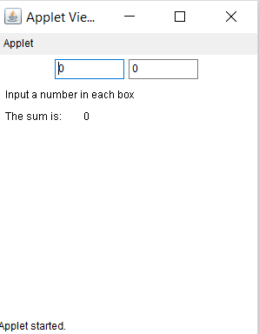
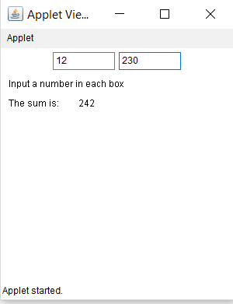
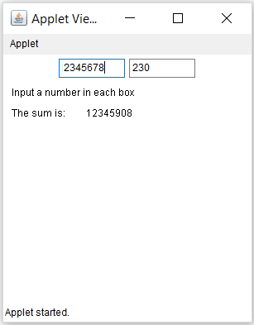
Passing a Parameter to Applet

